Slide 1
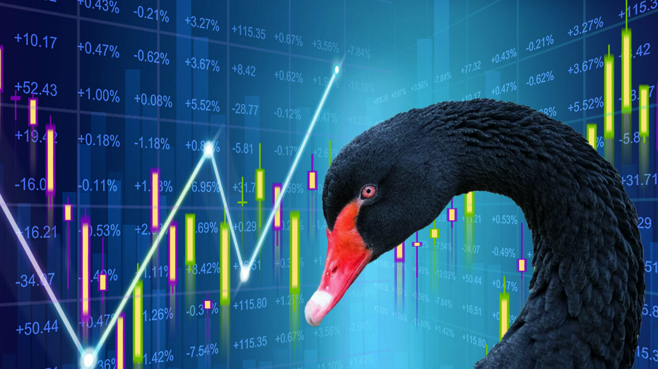



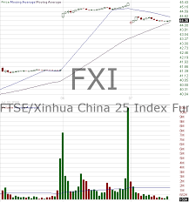

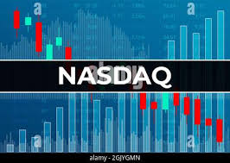


Index Analysis
Goal:
Investor Protection
Retirement
Asset value preservation against market losses
Safe-haven during down trends
.05% yield as minimum cost for asset protection
Quick on-chain re-deployment thru blockchain transfers
Triggers:
Volume
Price Changes
% Change

Slide 2
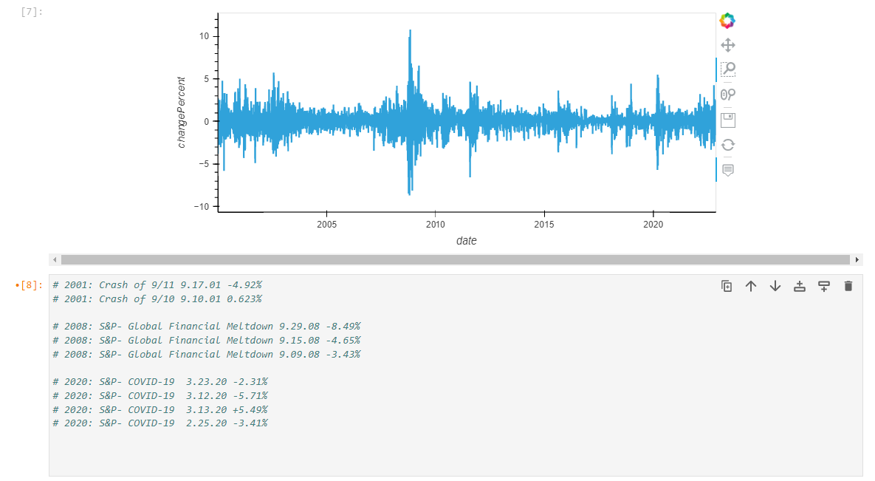
Index Analysis (Example: S&P500)
Boundary Conditions
E71
E72
Set Black Swan onboarding signal at -3%
Black Swan Events result in percentage change drops between ~5-8.5%.
3.12.2001: The S&P dropped -4.3% and again
4.03.2001: Almost a month later by -3.4% five months before 9/11

Slide 3
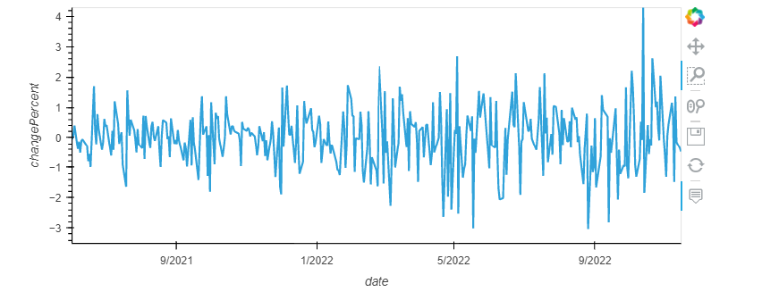
Further Proof:
Set Black Swan Trading signal at -3%
Black Swan Trading Signal (BSTS) would have triggered on these two days 5.18.2022: -3.16% and again on 8.26.2022: -3.36%
What happened on November 11th 2022?

Slide 4
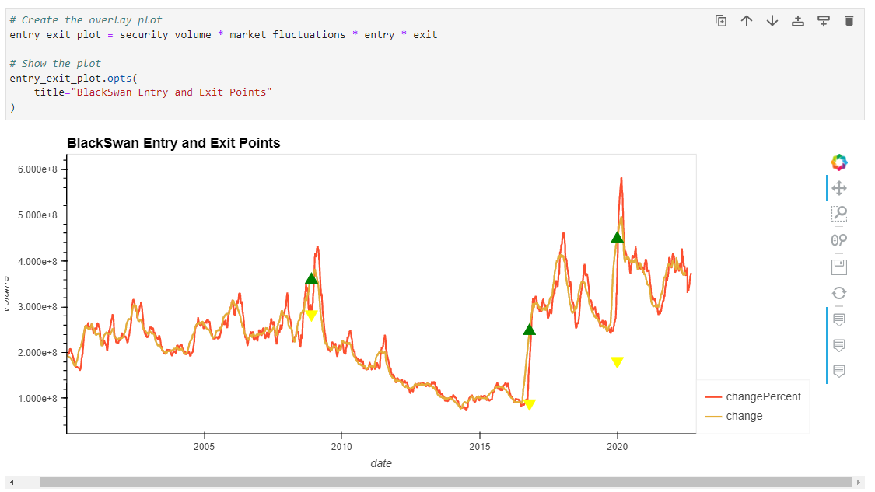
Black Swan ‘Signaling’ in Python
Next Step:
Time Series & MonteCarlo Analysis
Predict Future Patterns
Estimate a time period frequency for Black Swan events
Black Swan Trading Signal (BSTS) would indicate when to enter the token for protection against downtrending market conditions and when to re-enter.

